Slide 1
Interim / Fractional Leadership
Characteristics of Successful Intervention

Slide 2
Successful interim leaders possess:
Communication Skills
Expert Knowledge
Player / Coach
Results Oriented
Team Player / People Skills
Honesty
Professionalism
Keeping Ego in Check

Slide 3
It’s a new world.. Fractional leader seamlessly deliver change

Slide 4
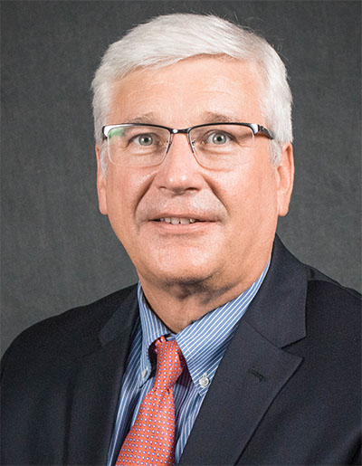
Michael Bach
Mike is passionate about executional excellence, leaders who operate with conviction and building next generation leaders.
Projects undertaken surround mentorship on achieving all aspects of AOP (Annual Operating Plan) business plan attainment, include leadership coaching of clients’ top talent. Operating as a “player / coach”, Mike mentors what good looks like.
With two decades as a global Package Goods executive, Mike has developed specific expertise in negotiation leadership, executing AOP Business Plans (building, measuring, re-planning and building sales, marketing and logistics execution strategies), leading direct, broker and distributor sales and marketing organizations, and creating future general manager / functional leaders, for companies who conduct business with the world’s largest retailers.
Mike’s experience was developed working with Procter & Gamble, The Minute Maid Company, piloting the Company’s first Wal-Mart Customer Development Team for The Coca-Cola Company, SCA / Johnson & Johnson and others.
At Coca-Cola Africa, his team delivered +30% CAGR growth for the company and its distributors, by extending reach of the Brand, negotiating channel / shopper marketing campaigns and pay-for-performance customer trading terms and delivering diversity improvements, throughout the organization of the continent’s #1 ranked brand.
At Management Ventures Inc. (a global retail trade management research, training and information services firm) Mike served as Chief Operating Officer, leading the company’s team of retail analysts and trainers to translate and simplify global retailer business objectives into syndicated training, consulting and E-learning platforms.
Mike’s industry experience includes global retail, fast moving / consumer package goods, utilities, airlines and service businesses. An advocate for “selling more, profitably”, Mike has been an Endeavor Global Mentor for over 5 years, assisting new to market entrepreneurial companies to fast-track their go to market plans.
A more detailed update is available on Mike’s LinkedIn profile.

